Slide 1

Flexible Telepresence Robot Assembly (FLEXTRA)
JI Covid-19 Challenge
Team 4
Chongdan Pan
Qin Huang
Mengyu Xiao
Yushi She
Mentor: Sparkl Xiao

Slide 2
Content
Introduction
Background
Target Customer
Concept Design
Validation
Application
Business
model

Slide 3
Background
Why？
3.3 million people infected by Covid-19 worldwide.
¥10000 required to protect each high-risk workers per month
Who？
Billions of high-risk workers in hospitals, communities and public areas like airports.
How?
Control a low-cost robot to do their jobs
Lower their risk to get infected during work
Notes:
Until May 1st, the coronavirus has spread to almost every country in the world, and the total number of infected people reaches to 3.3 million worldwide. Many countries are still at the beginning of this pandemic. As a result, the infected people will keep increasing in the near future.
With the pandemic getting more and more worse, the medical resources and staffs are overwhelmed by the infected people. For those old people, who are more susceptible of this virus, they can’t get enough medical cares from the hospitals. Also, since many countries have taken the social distancing rules to contain and slow down the spreading of the virus, it’s difficult for many elderly to take medicine on time.

Slide 4
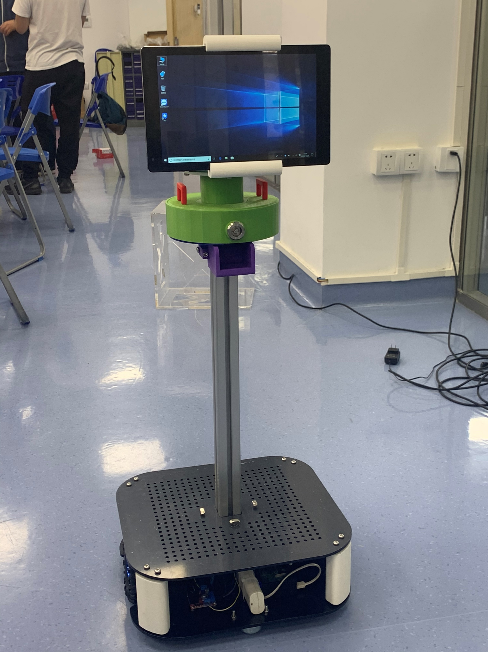
Solution: Flexible Telepresence Robot Assembly （FLEXTRA）
Robot:
No need of protection.
Powerful mechanic devices
Flexibility:
Easy to move around
Work in different scenarios with attachments
Telepresence technology:
Video connection with remote controller
Overall View for the Robot
Notes:
介绍FLEXTRA的定义 The Flexible Telepresence Robot Assembly is robot that supports instant video calls, smart medicine dispensation and remote control. It can be flexibly combined with other attachments to adapt different scenarios. In this global pandemic, FLEXTRA can be used to replace human to work in dangerous places, such as hospitals, to reduce the chance of being infected. This robot can also save a lot of PPE(personal protection equipment) for those doctors and nurses in the hospitals.

Slide 5


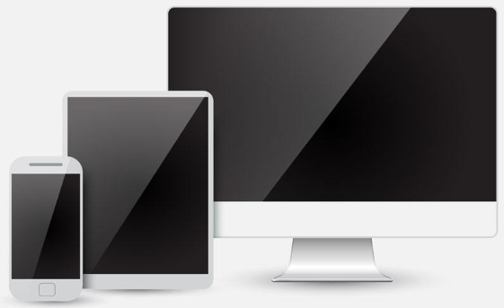
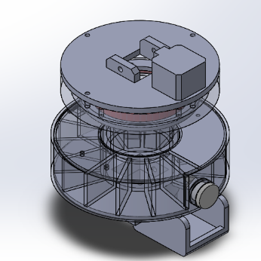
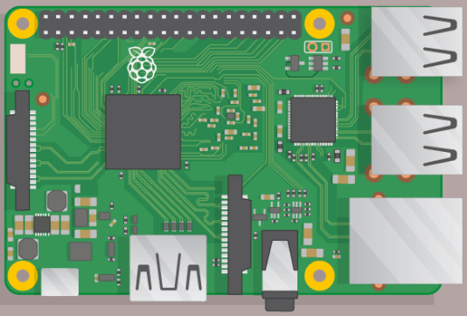
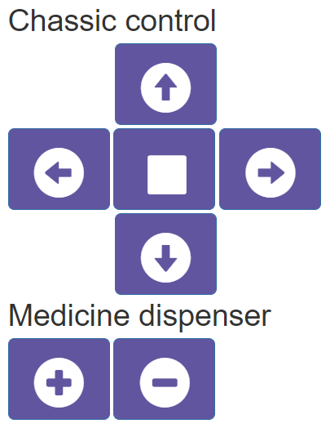
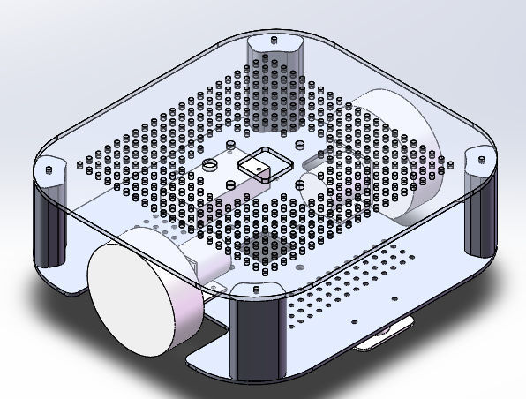
Robot Concept Diagram
Video Call
Navigation
Tablet on the Robot
e.g. Medicine Dispenser
Controller’s PC/Tablet/Phone
Output System
Robot Movement
Raspberry Pi
User Interface
Chassis
Notes:
工作模式：
用户可以使用电脑，手机，平板等手头的电子设备，登录网页通过user interface来控制FLEXTRA上的平板和raspberry pi. 平板可以用来进行视频通话，监控机器人周围环境，并提供一些列应用。树莓派可以控制机器人上的电控设备，包括控制电机发药，移动机器人，读取传感器数据等。
Users can use computers, smart phones and Ipads to log into the user interface on the website to control the ipad and raspberry pi on the FLEXTRA. The Ipad on the FLEXTRA can be used to take instant video calls, monitor the surrounding of the robot and provide other apps depending on the target users. The raspberry pi will control the electronic devices on the robot. It controls automatically delivering medicine, moving the robots and processing data from sensors.

Slide 6
Content
Intro
Mechanic Design
Circuit Design
Cost Estimate
Prototype Video Demo
Validation
Application
Business
model
Notes:
Until May 1st, the coronavirus has spread to almost every country in the world, and the total number of infected people reaches to 3.3 million worldwide. Many countries are still at the beginning of this pandemic. As a result, the infected people will keep increasing in the near future.
With the pandemic getting more and more worse, the medical resources and staffs are overwhelmed by the infected people. For those old people, who are more susceptible of this virus, they can’t get enough medical cares from the hospitals. Also, since many countries have taken the social distancing rules to contain and slow down the spreading of the virus, it’s difficult for many elderly to take medicine on time.

Slide 7
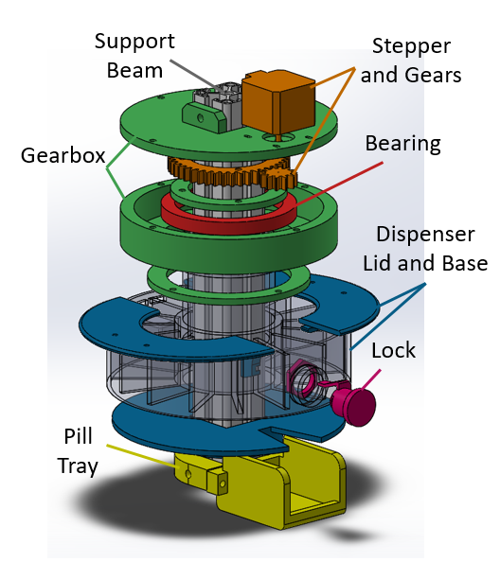
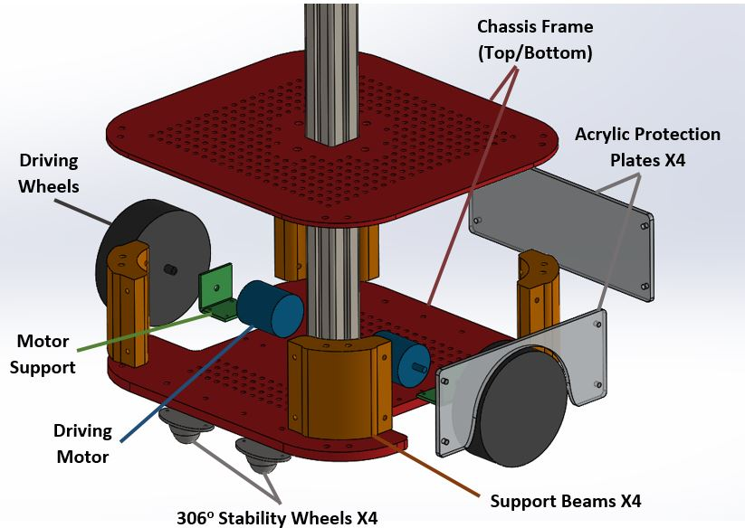
Robot Mechanical Design
Explosion View of Chassis
Mainly 3D-printed
Easy to modify for other functions
Explosion View of Medicine Dispenser
Notes:
底盘的结构设计,主要包括左右两个马达，亚克力板和3D打印支撑件和万向轮omni wheel

Slide 8

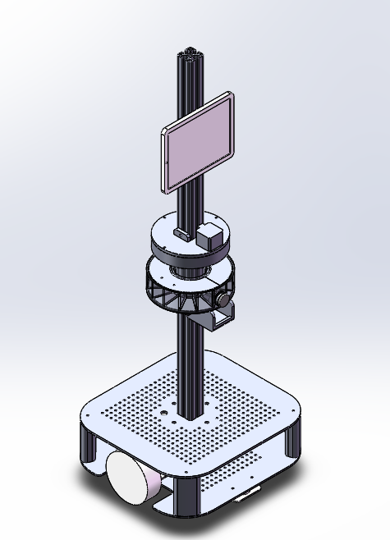
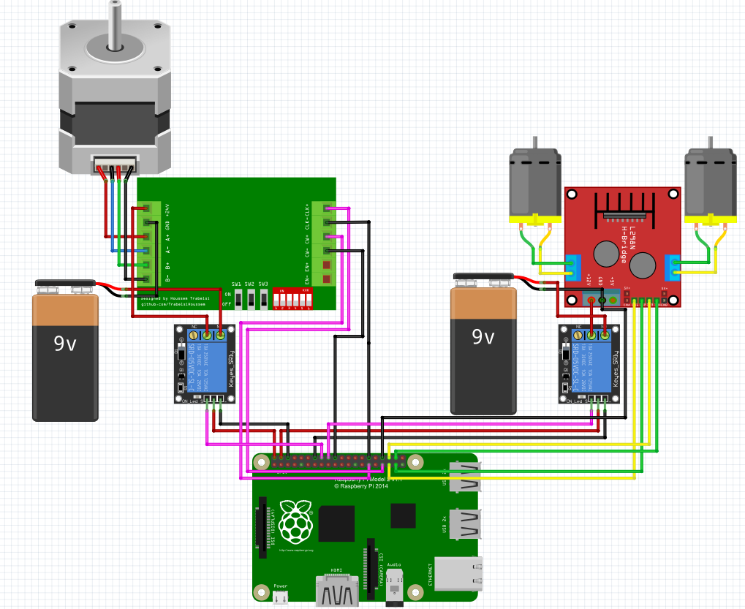
Robot Circuit Design
Dispenser Output
Chassis Movement
Overall View for the Robot
Robot Circuit Design
Notes:
树莓派的电控结构设计。左侧为继电器，用来drive step motor来分发药物。右侧为底盘马达的drive board，用来控制机器人移动.分别用9V电池作为电源。

Slide 9
Prototype Cost Estimates
# | Hardware | Prototype
1 | Raspberry pi as controller of chassis with network card for remote control | 420
1 | Raspberry touch screen, to get calibration for raspberry’s connection | 214.12
1 | Extension board and speaker for raspberry pi video call | 100
2 | Motors for moving chassis | 87
1 | Acrylic board for first chassis structure | 170
1 | Power system and charger | 267
1 | Motor driver board and wires for chassis | 105.66
4 | Wheels for moving chassis structure | 104.8
1 | Camera module for video call | 150
1 | Tablet PC with windows 10 operating system for remote control and video call | 1300
 | Total Estimate Cost | 2918.58
Notes:
Prototype的开发成本和制造成本

Slide 10
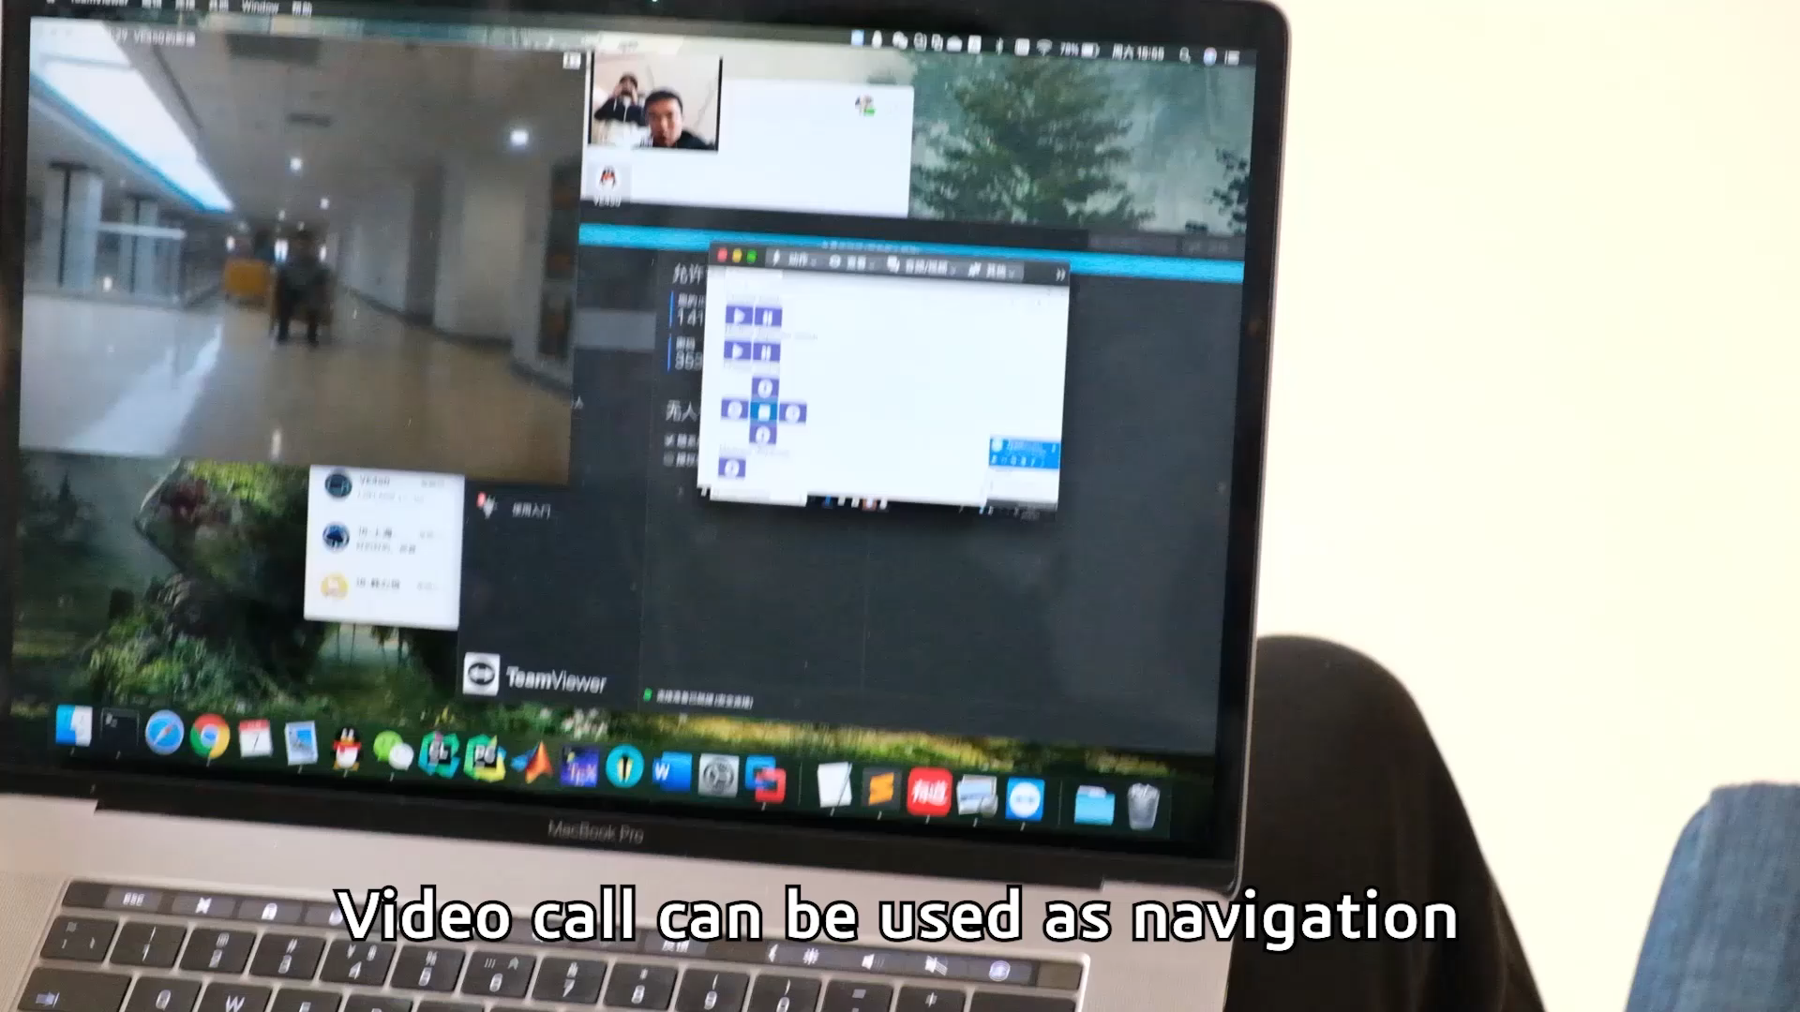
Key Function Validation
Notes:
This video shows basic functions of FLEXTRA, including remote control and pills dispensation. In pandemic management, FLEXTRA can play a role in different scenarios with attachments like thermometer.

Slide 11
Content
Intro
Validation
Temperature measuring in public area
Remote consultation in neighborhood or hospital
Contactless delivery in wards
Application
Business
model
Notes:
Until May 1st, the coronavirus has spread to almost every country in the world, and the total number of infected people reaches to 3.3 million worldwide. Many countries are still at the beginning of this pandemic. As a result, the infected people will keep increasing in the near future.
With the pandemic getting more and more worse, the medical resources and staffs are overwhelmed by the infected people. For those old people, who are more susceptible of this virus, they can’t get enough medical cares from the hospitals. Also, since many countries have taken the social distancing rules to contain and slow down the spreading of the virus, it’s difficult for many elderly to take medicine on time.

Slide 12
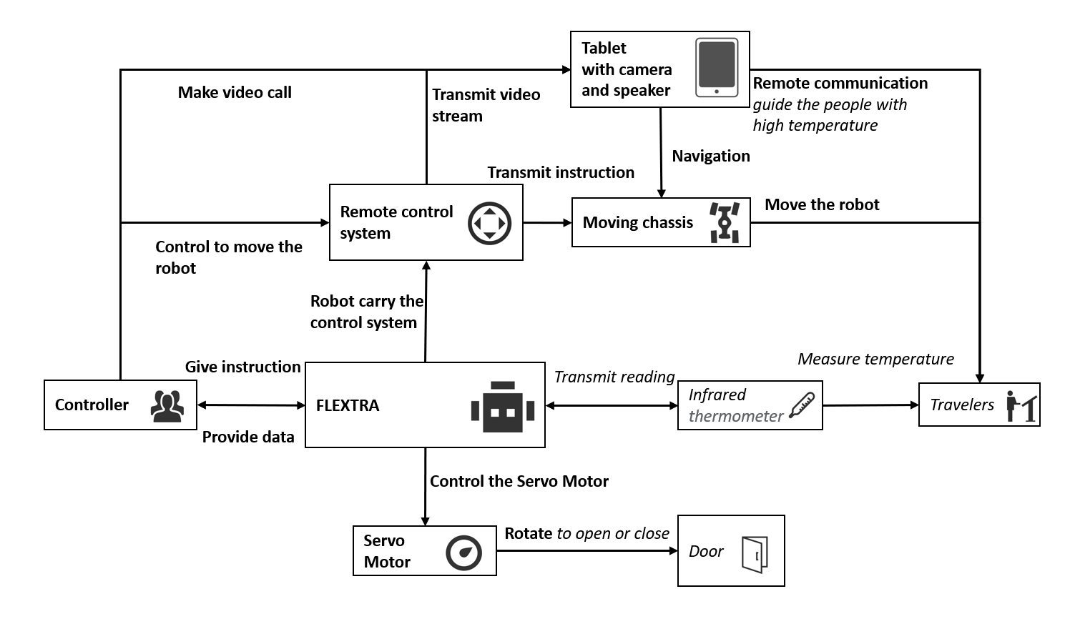
Measure temperature & Organize people
Notes:
The following architecture diagrams will show how it works, bold text shows the FLEXTRA’s basic function, and italic texts represents for the attachments.
In public area, the robot can measure people’s temperature and allow them to pass if they have normal temperature. Compared to human, the robot can measure multiple people’s temperature at once. Compared to （市面上某种测温机器人), our robot’s video call system allows controllers to stay on top of the situation and communicate with people. It can also control people movement.

Slide 13
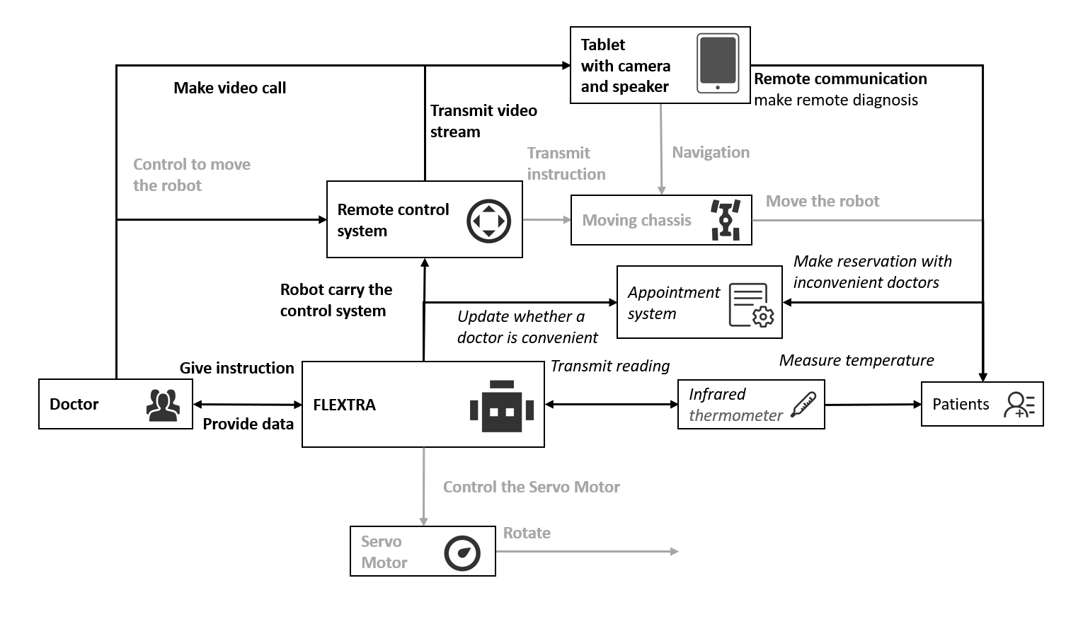
Remote consultation
Notes:
The robot can provide people with remote consultation and reception with medical professionals. Doctor can use the robot to The robot’s appointment system can maintain order for consultation wherever in hospital or housing estates, which is a big problem in Chinese hospital. Compared to normal reception robot in hospitals, FLEXTRA is more flexible to move, and it can make video consultation. In addition, patients can get basic diagnosis through video communication with doctors and thermometer instead of meeting a doctor face to face.

Slide 14
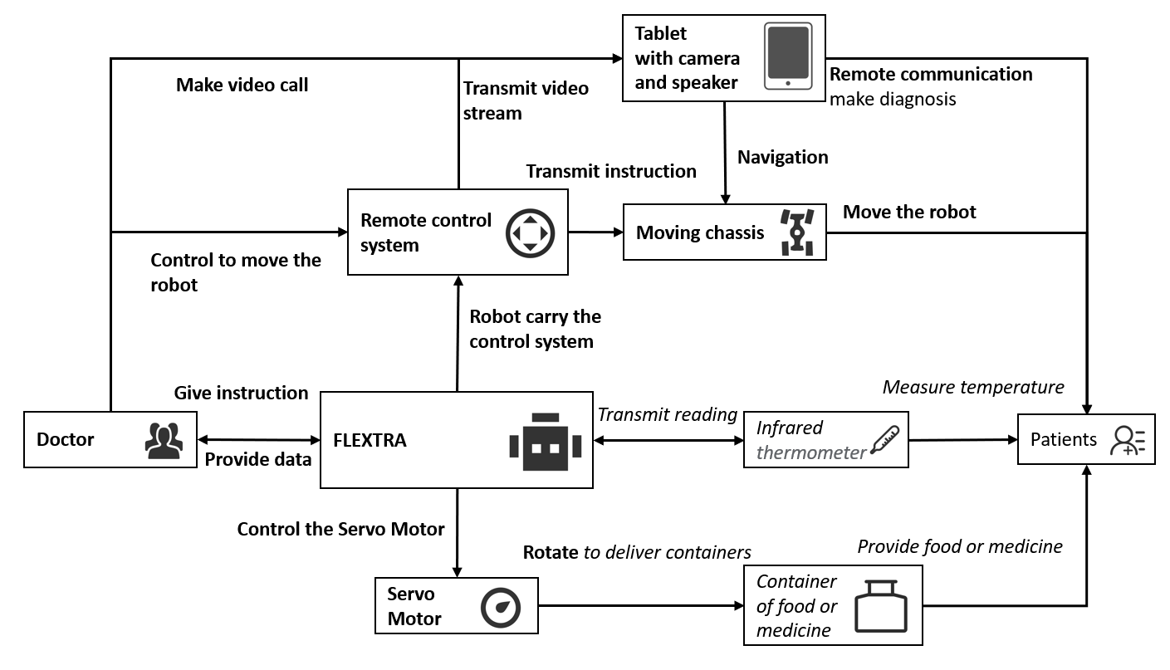
Contactless delivery
Notes:
In wards, the robot can save lots of time and resources through contactless delivery since it doesn’t need protection measures. Doctors can control the robot to move around to deliver food or pills from office. The video communication system and thermometer can also help them to make simple diagnosis during delivery.

Slide 15
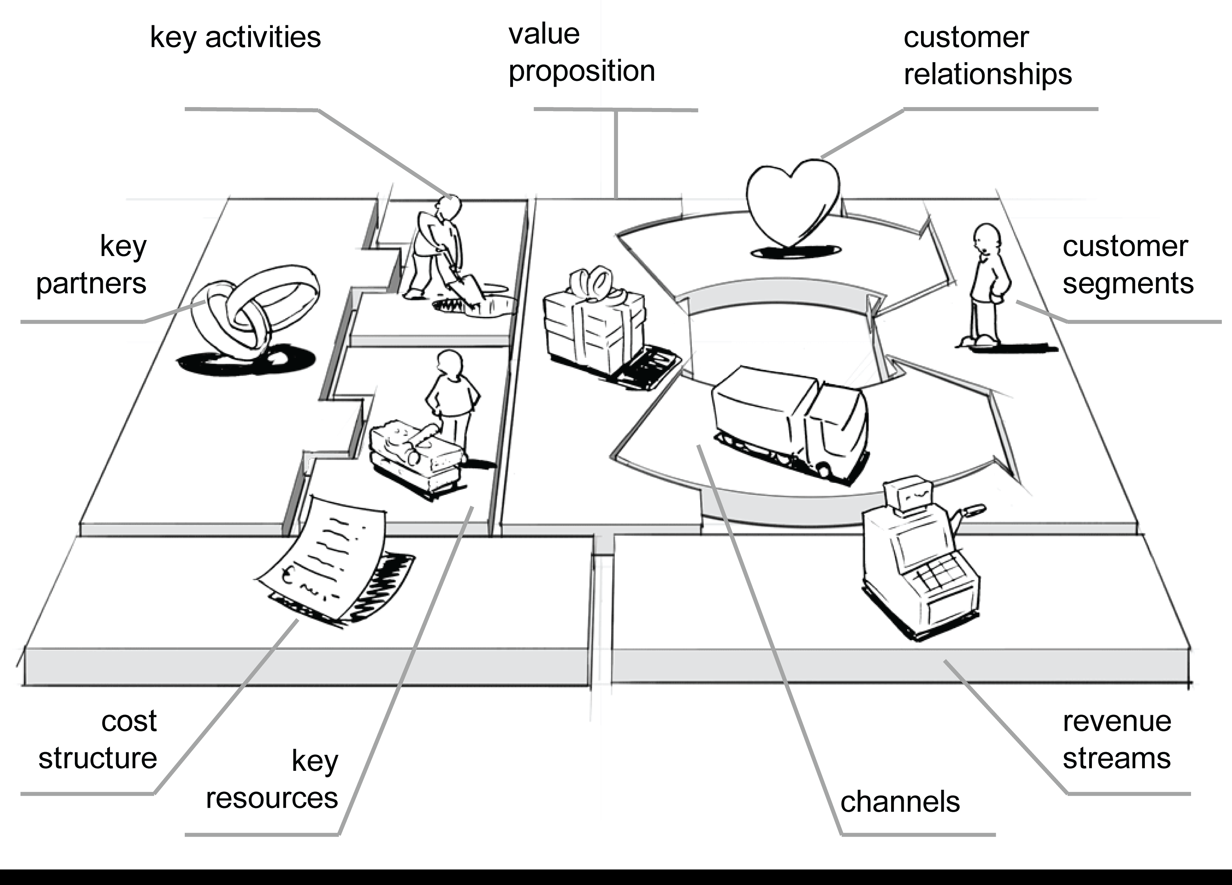

Content
Intro
Validation
Application
Business
Model
Notes:
Until May 1st, the coronavirus has spread to almost every country in the world, and the total number of infected people reaches to 3.3 million worldwide. Many countries are still at the beginning of this pandemic. As a result, the infected people will keep increasing in the near future.
With the pandemic getting more and more worse, the medical resources and staffs are overwhelmed by the infected people. For those old people, who are more susceptible of this virus, they can’t get enough medical cares from the hospitals. Also, since many countries have taken the social distancing rules to contain and slow down the spreading of the virus, it’s difficult for many elderly to take medicine on time.

Slide 16







Value Proposition
Lower people’s risk of being infected during work
Save time, medical resources and cost
Notes:
In wards, the robot can save lots of time and resources through contactless delivery since it doesn’t need protection measures. Doctors can control the robot to move around to deliver food or pills from office. The video communication system and thermometer can also help them to make simple diagnosis during delivery.

Slide 17
Cost structure & Revenue Stream
Prototype Cost: ¥2919
Fabricating Max Cost : ¥2000
Product Cost
R&D: ¥1000
Labor: ¥1000
Total: ¥4000
Rental Prices: ¥1000/month/robot
4 months to cover the cost
Save ¥9000/month/robot/job for users
Sell Prices: ¥4500/robot
Revenue Stream
Notes:
Revenue stream以租借收入为主,可以添加销售的价格 租借一台一个月1000元是个参考价位

Slide 18
Market Analysis & Customer Segmentation
32000 Hospitals
50 Robots
350000 Schools & Housing estates
3 Robots
Over 2700000 Robots
2300 Airports, Seaports & Railway Stations
25 Robots
Market Scale: Over ¥10.8 Billion in China
Save Over ¥24.3 Billion

Slide 19
Implementation Key
Key Resources
Powerful engineering team
Sponsorship with key partners
Key activities
Research and Development (R&D)
Regular interviews with customers for updating robot
Key Partners
Attachments developers
Government & Communities
Hospitals
Notes:
这5块大致内容只需要拓展一下，但需要重新排版

Slide 20
Feasibility & Customer Relationship
Get
Grow
Attract users through features
Free trial at small place
Door to door delivery
Generalize & develop new features
Work with more attachments
Advertise the product and its effects
Keep
Make improvements based on feedbacks
Sell and rent the product
Run regular maintenance checks
Notes:
这页最好还能搞个步骤图之类的

Slide 21
Thank you

